Slide 1
Secure data hiding in images using steganography
CAPSTONE PROJECT
Presented By: Dharmik Jain ParasKumar
Student Name : Dharmik Jain
College Name & Department : Drs. Kiran and Pallavi Patel Global University Diploma Computer Engineering

Slide 2
OUTLINE
Problem Statement : Page nu: 3
Technology used : Page nu: 4
Wow factor : Page nu: 5
End users : Page nu: 6
Result : Page nu: 7
Conclusion: Page nu: 8
Git-hub Link: Page nu: 9
Future scope: Page nu: 10

Slide 3
Problem Statement
With the increasing amount of digital communication, ensuring data confidentiality is a major challenge. Traditional encryption methods are vulnerable to cyber threats, making secure data transmission crucial. Steganography provides an innovative approach to embedding sensitive data within images, making it nearly undetectable to unauthorized users. This project aims to enhance data security by leveraging advanced steganographic techniques.

Slide 4
Technology used
Programming Language: Python
Libraries: OpenCV, NumPy, PIL (Pillow), Cryptography
Platform: Windows/Linux
Additional Tools: Jupyter Notebook/PyCharm for development

Slide 5
Wow factors
Enhanced Security: Uses cryptographic encryption before embedding data into images.
Undetectable Communication: Data is hidden in image pixels without altering visual
appearance.
Multi-Layer Protection: Combination of steganography and encryption ensures
high-level security.
Custom Encoding Algorithm: Optimized algorithm to improve data embedding
efficiency and resistance to attacks.
User-Friendly Interface: Simple GUI for easy encryption, embedding, and extraction.

Slide 6
End users
Government Agencies: Secure transmission of confidential information.
Journalists & Whistleblowers: Safe communication without detection.
Corporate Sector: Protecting sensitive business data.
Cybersecurity Professionals: Secure storage and sharing of private keys or credentials.

Slide 7
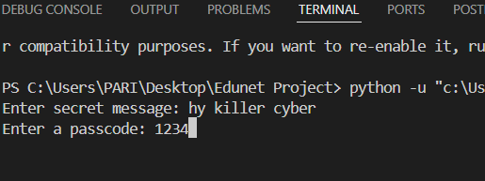
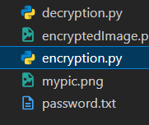

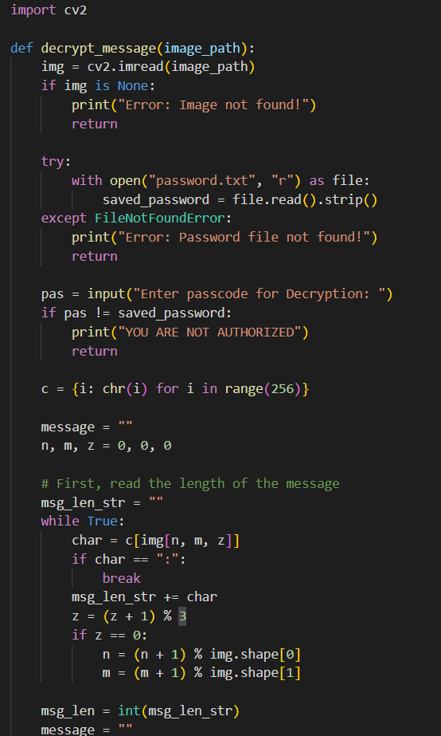
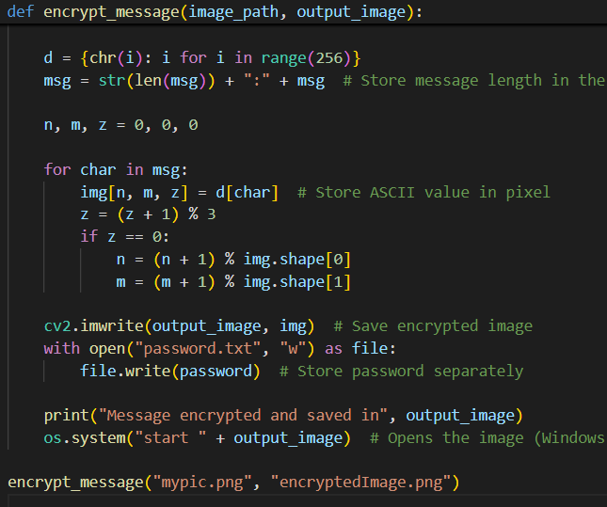
Results

Slide 8
Conclusion
This project provides an effective solution for securely hiding sensitive data within images using steganography. By integrating cryptographic techniques, it ensures high-level security while maintaining the visual integrity of images. The project successfully addresses the problem of secure data transmission, making it an invaluable tool for privacy protection in digital communication.

Slide 9
GitHub Link
Click On Click Word Sir/Mam

Slide 10
Future scope(optional)
Integration with Blockchain: Enhancing security by using decentralized authentication.
Real-Time Data Steganography: Implementing live video steganography for dynamic communication.
AI-Based Image Selection: Using AI to optimize image selection for better data hiding.
Cross-Platform Mobile Application: Developing an Android/iOS app for on-the-go secure messaging.

Slide 11
THANK YOU

